Slide 1
JavaFX UI elementlaridan foydalanish.
(Tabpane , Tab, Mediaview, Webview)
Guruh-4 (Humoyun Saydullayev, ArofatBabaniyazov )
Yeouju technical institute in Tashkent
2022-yil
18

Slide 2
Mavzu rejasi:
Tabpane va tab
2. Mediaview va Webview
2

Slide 3
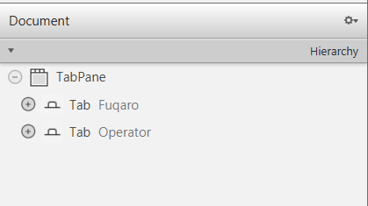
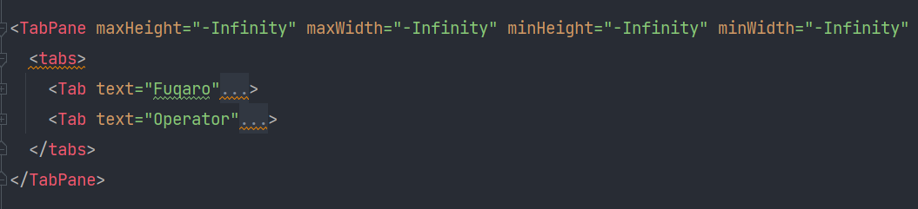
Tabpane va tab
Tabpane va tabning Scenebuilder ko’rinishi
Tabpane va tabning Javada kod ko’rinishi
3

Slide 4
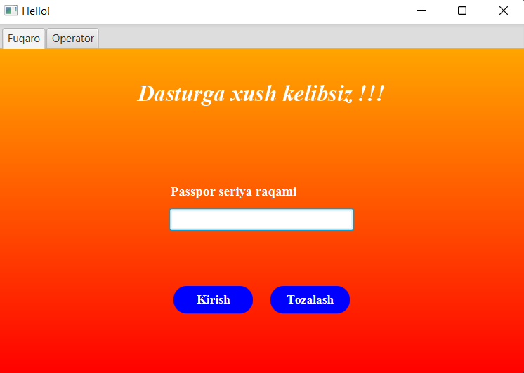
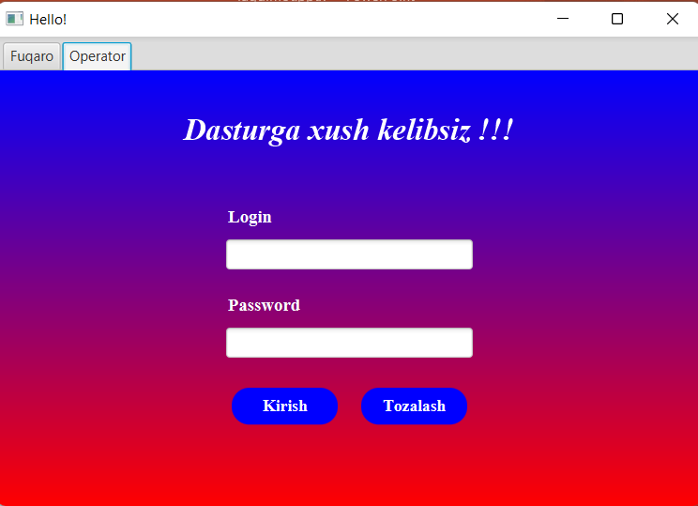
Tabpane natijasi va tablarni almashtirish
4

Slide 5
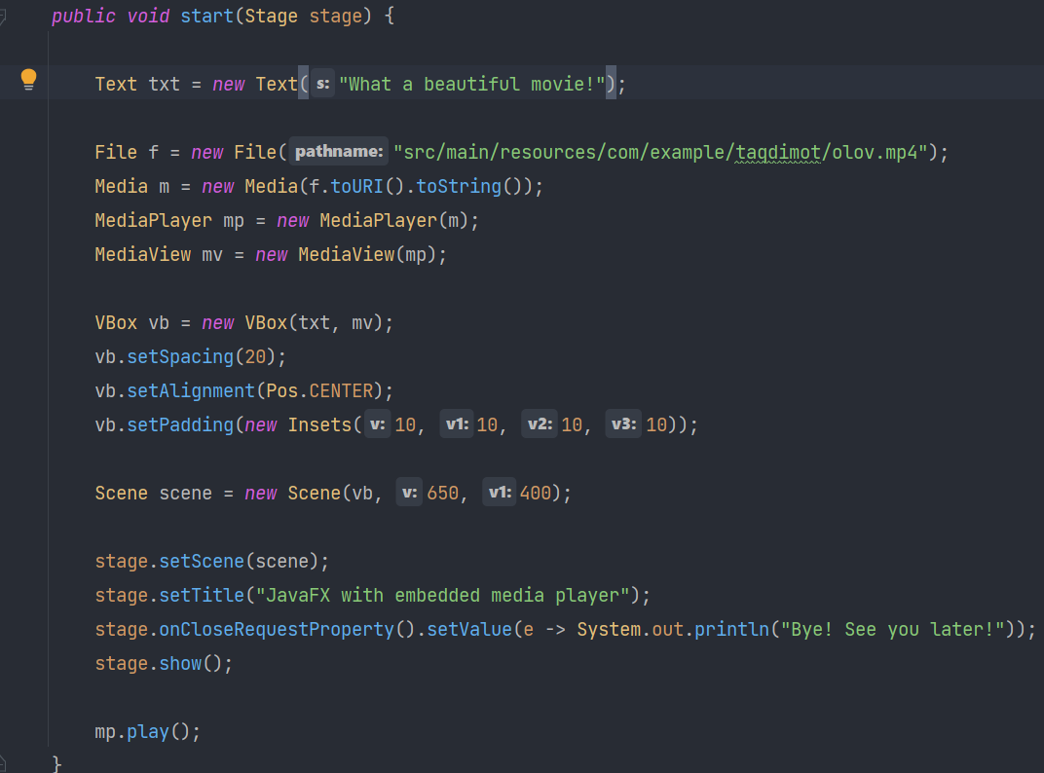
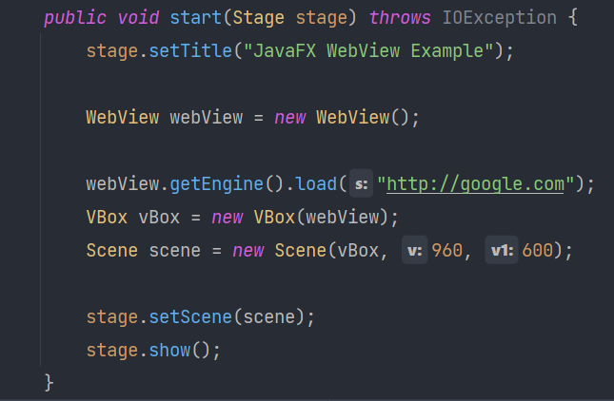
Mediaview va Webview
Mediaview va Webview java kodlari
5

Slide 6
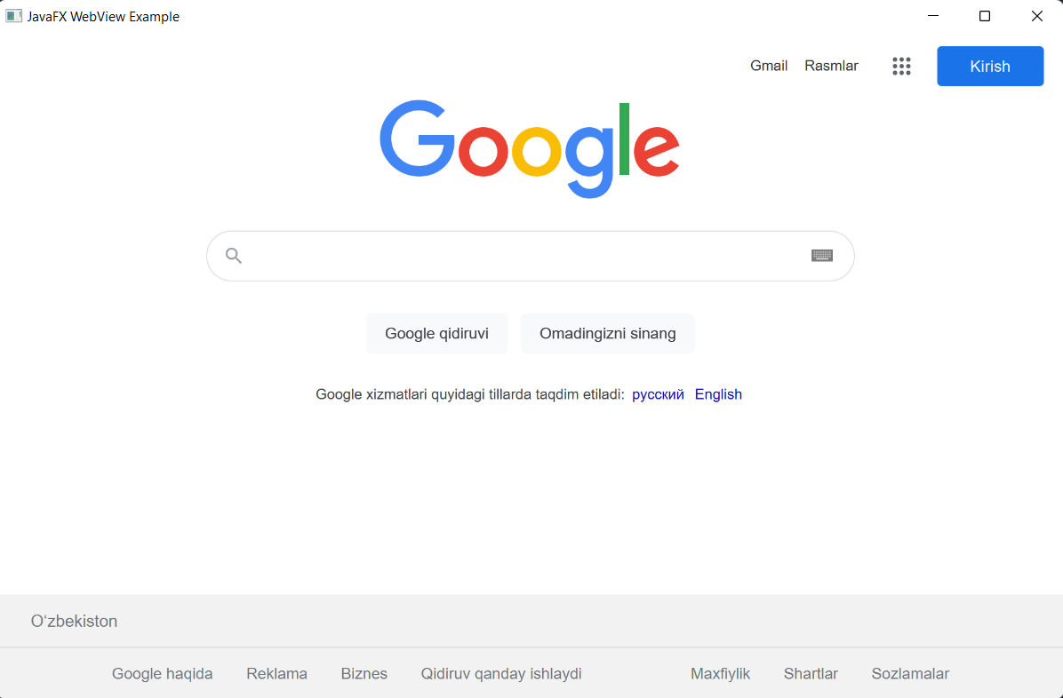
Webview natijasi
6

Slide 7
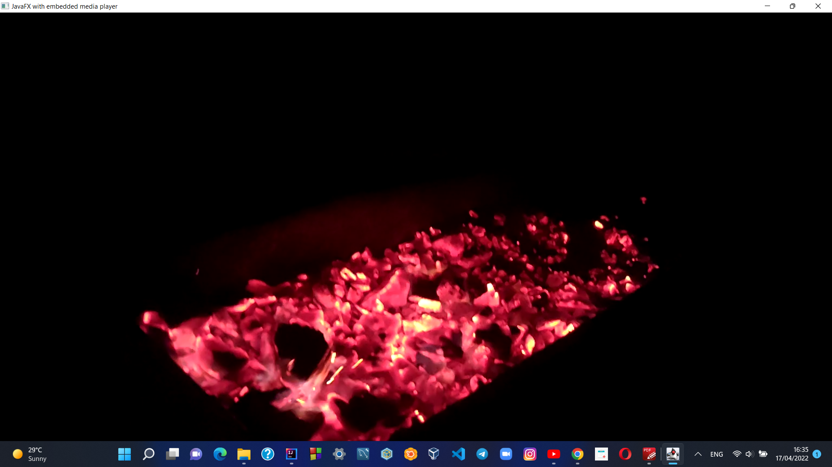
Mediaview natijasi
7

Slide 8

8

Slide 9
E’tiboringiz uchun rahmat !!!
9

